Slide 1

11th Global Islamic Microfinance Forum
Sukuk market: opportunities and trends
Source: https://cbonds.com/

Slide 2
Key figures
Global outstanding sukuk reached USD 767 bln at end-3Q22
It is a growing market with an annual rate of 15-17%. Forecast to 2027: about USD 1500 bln
Global outstanding sukuk includes Domestic bonds outstanding: USD 583 billion (3500 issues) and International bonds USD 184 bln (230 issues)
Global sukuk issuance includes Domestic bonds annual issuance: about USD 130 billion (1000 issues), International bonds – about USD 35 bln (40 issues). Annual growth rate of issuance: 5-10%.
Source: https://cbonds.com/

Slide 3
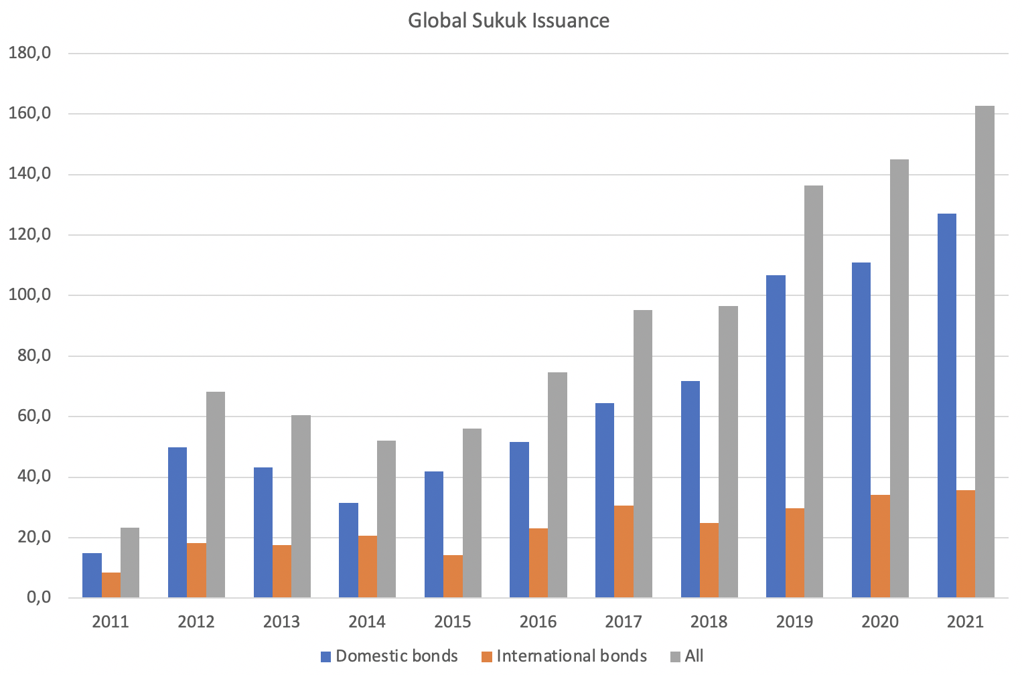
Source: https://cbonds.com/

Slide 4
Growth factors
More regulations and policies have been introduced to improve standardization
Preferential taxation
Volatility in oil prices
Social and ethical point of view: Sukuk finance is a desirable solution for large-scale projects, avoiding interest arrears (“Riba”), which is prohibited by Islamic law
Sukuk bonds are recognized as a more “ethical” way of attracting financing that has a positive impact on society, which is also consistent with the growing adoption of ESG investing
The large investor base, consisting of sharia-compliant investors
Sukuk bonds are also becoming increasingly popular geographically with a large Muslim population
Source: https://cbonds.com/

Slide 5
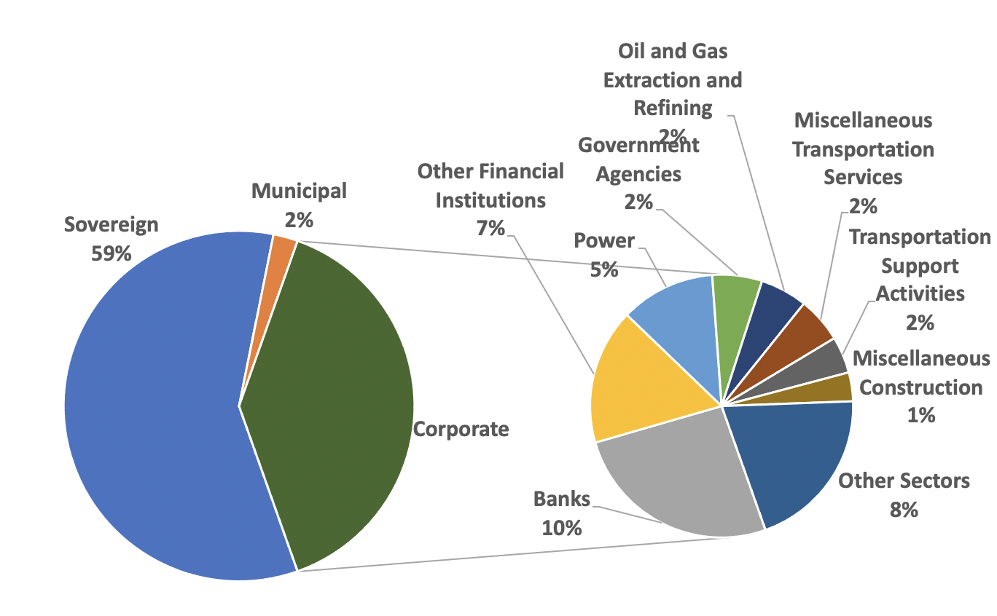
More details about the market: Breakup by Issuer Type
Source: https://cbonds.com/

Slide 6
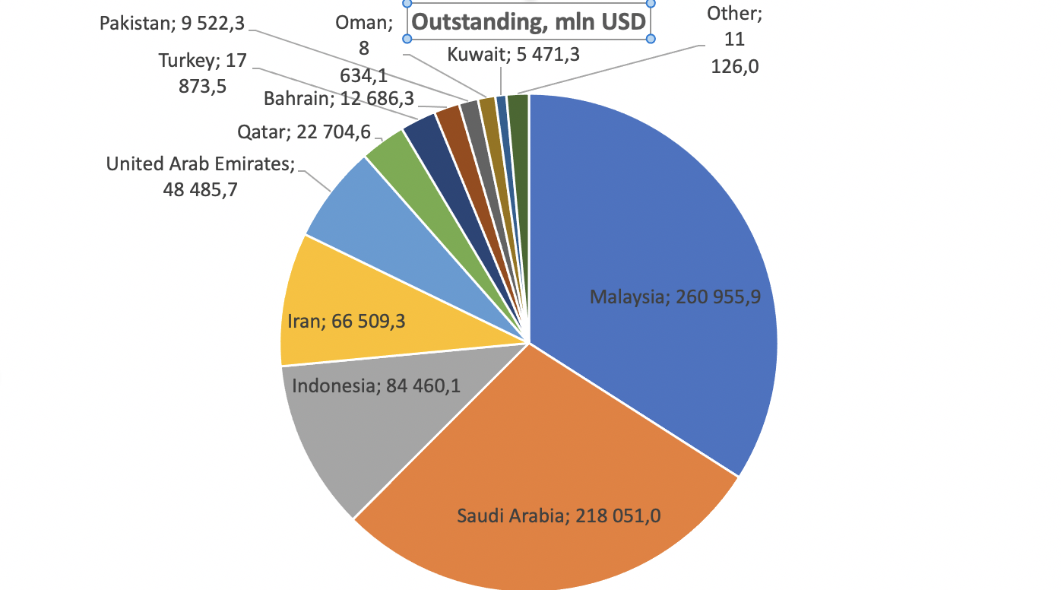
Breakup by Country
Source: https://cbonds.com/

Slide 7
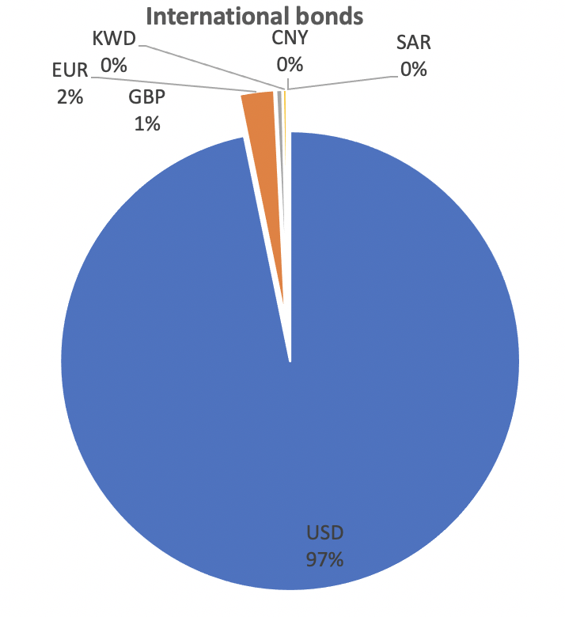
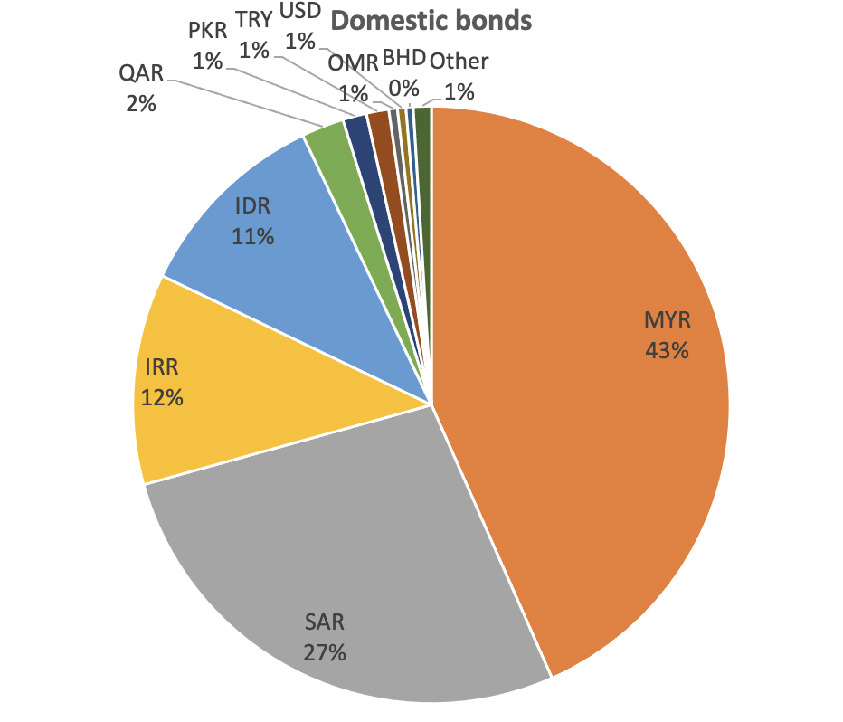
Breakup by Currency
Source: https://cbonds.com/

Slide 8
Breakup by Sukuk Type, Issuance 2019-2022
Type | Volume, USD bln | Number of issues
Murabaha | 149,39 | 1503
Ijara | 50,37 | 365
Wakala | 27,04 | 352
Musharaka | 23,52 | 292
Mudaraba | 16,99 | 170
Murabaha and Wakala (Hybrid Sukuk) | 4,30 | 139
Ijara and Wakala (Hybrid Sukuk) | 1,09 | 48
Istisna | 0,44 | 21
Intifa'a | 4,58 | 16
Mudaraba / Murabaha (Hybrid Sukuk) | 8,12 | 15
Wakala, Mudaraba (Hybrid Sukuk) | 0,09 | 5
Source: https://cbonds.com/

Slide 9
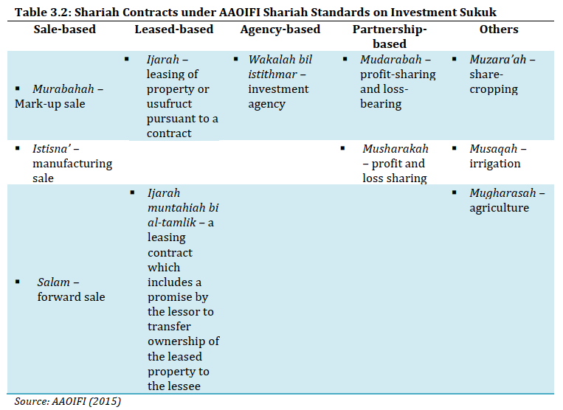
Source: The Role of Sukuk in Islamic Capital Markets, COMCEC,February 2018

Slide 10
Glossary of types of Sukuk
Murabaha is the most popular Islamic financing instrument. The word Murabaha derives from the Arabic word Ribh, meaning profit. It is a sale contract in which the price of the commodity is determined, including an agreed profit margin, this margin can be seen as a payment for the services provided.
Ijara is a form of sukuk derived from the ijara lease financing structure. Ijara is a form of lease agreement subject to which one party is entitled to dispose of predetermined benefits. These benefits are produced by the asset of the other party against payment. The Ijara agreement must follow two principles: the payment must not be an interest payment; no transfer of ownership takes place during the agreement term.
Wakala is a form of sukuk that stems from the concept of a wakala, which means an arrangement whereby one party entrusts another party to act on its behalf. A wakala is akin to an agency agreement, which has a principal and an agent (manager). The principal (investor) appoints an agent to invest on its behalf.
Musharaka is an Islamic mode of financing in the form of a partnership or a joint venture between two partners, “for example the bank and its customer”. Each party contributes to the capital of the partnership in equal or varying degrees.
Mudaraba is one of the forms of investment in Islamic finance. At its core, Mudaraba is based on the partnership between wealthy and experienced people “capital and work”. So that the first party provides their money while the second party provides their expertise for the purpose of making a profit, which is divided between them in agreed rates.
Istisna contract is a purchase contract for future delivery of an asset between two parties, one of whom (the manufacturer) submits a specific request with certain specifications to the other party (the buyer). In Arabic, Istisna means “asking someone to manufacture”.
Intifa’a, i.e., utilization of an asset, without the right to dispose of the right of utilization (the usufruct or manfa’ah). Sukuk al-intifa’a represent limited rights to the real estate being utilized. The limited rights on the real estate are associated with a limited period of time (tenure).
For more details, see here: https://cbonds.com/glossary

Slide 11
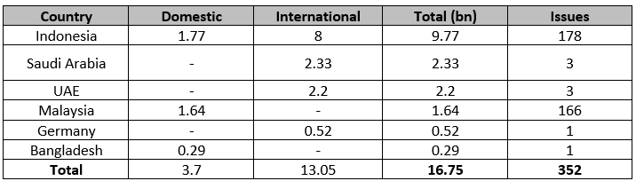
Total Outstanding Green Sukuk
The green sukuk has had a great impact on the green economy and has contributed to the doubling of railway construction and the creation of solar energy projects, not only large projects, but also small projects in the field of education and social life. The largest Green sukuk issuing countries are Indonesia, then Saudi Arabia, then the UAE and Malaysia
Source: https://cbonds.com/

Slide 12
TOP country issuers
TOP sovereign issuers: Malaysia, Saudi Arabia, Indonesia, Iran
TOP Corporate issuers: Malaysia, Saudi Arabia, United Arab Emirates
TOP Municipal issuers: United Arab Emirates, Iran, Malaysia
Source: https://cbonds.com/

Slide 13
TOP corporate international bonds Issuers
Issuers | USD amount, mln | issues | Avg duration, years | Avg yield, %
Islamic Development Bank | 17 451,8 | 16 | 2,3 | 4,4
Saudi Electricity Company | 7 800,0 | 8 | 7,7 | 5,3
Dubai Islamic Bank | 7 550,0 | 9 | 2,6 | 5,7
DP World | 6 950,0 | 6 | 6,3 | 5,9
Saudi Arabian Oil | 6 000,0 | 3 | 4,6 | 5,1
First Abu Dhabi Bank | 3 577,3 | 6 | 2,2 | 5,2
Qatar Islamic Bank | 3 060,0 | 11 | 2,6 | 5,7
Riyad Bank | 2 250,0 | 2 | 5,8 | 6,1
Saudi National Bank | 2 000,0 | 2 | 3,9 | 5,7
Dar Al Arkan | 1 900,0 | 4 | 2,5 | 8,9
Emaar Properties | 1 750,0 | 3 | 6,4 | 5,7
Majid Al Futtaim Holding | 1 700,0 | 3 | 5,6 | 5,8
IDB Trust Services | 1 500,0 | 1 | 1,9 | 5,0
Sharjah Islamic Bank | 1 500,0 | 3 | 1,9 | 5,3
Masraf al Rayan | 1 440,0 | 4 | 2,4 | 5,6
Source: https://cbonds.com/

Slide 14
TOP corporate domestic bonds Issuers
Issuers | USD amount, mln | issues
DanaInfra Nasional | 16 549,1 | 140
Prasarana Malaysia | 8 406,6 | 76
LPPSA | 8 043,5 | 57
Projek Lebuhraya Usahasama | 6 205,9 | 17
Urusharta Jamaah | 6 063,2 | 2
Khazanah Nasional | 4 973,5 | 20
Perbadanan Tabung Pendidikan Tinggi Nasional | 4 643,4 | 35
Saudi Electricity Company | 4 061,3 | 3
General Authority of Civil Aviation | 4 056,0 | 1
Pengurusan Aset Air | 3 705,9 | 39
Saudi Real Estate Refinancing Company | 3 666,4 | 9
Tenaga Nasional | 3 631,1 | 19
Cagamas Berhad | 3 085,4 | 48
Saudi Arabian Oil | 2 999,8 | 1
Maybank | 2 750,9 | 7
Source: https://cbonds.com/

Slide 15
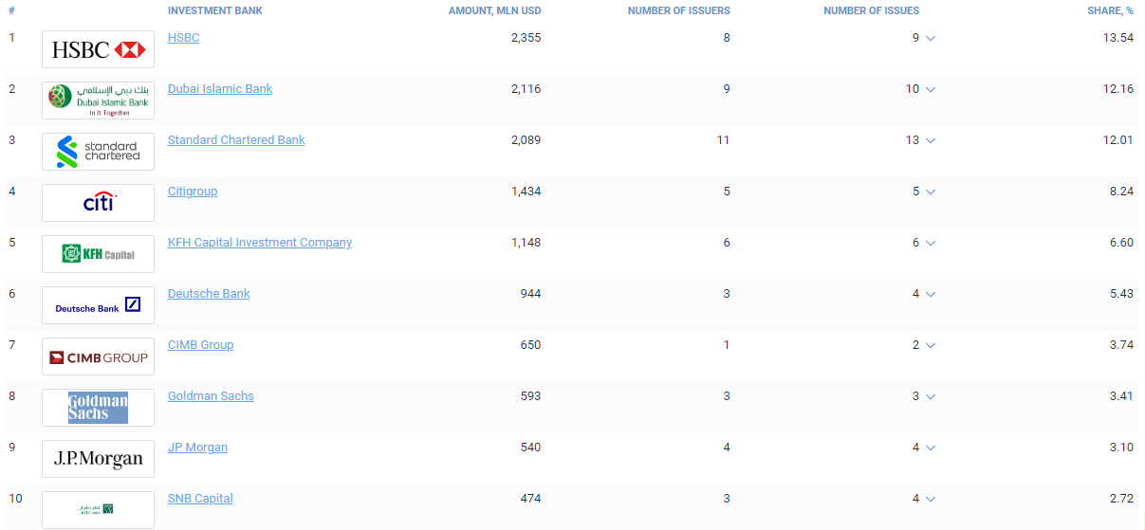
Bookrunner League Table of International Sukuk Bonds, Jan-Oct 2022
Source: https://cbonds.com/rankings/721/2507/

Slide 16
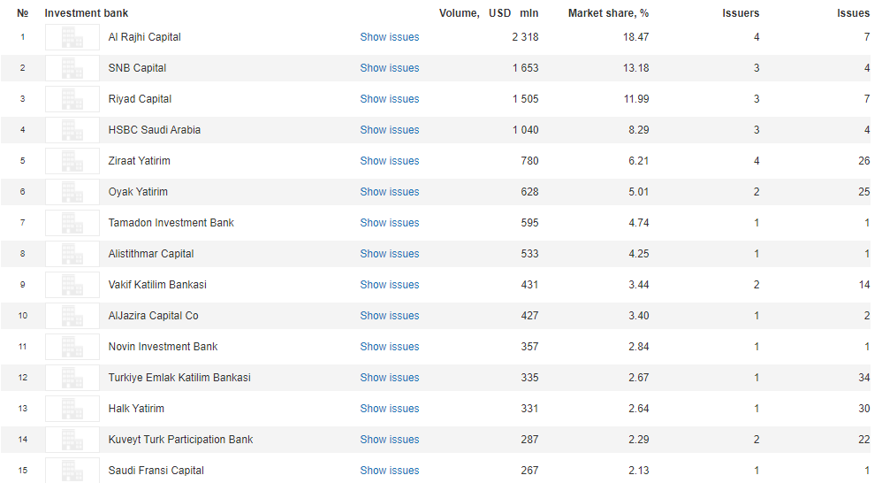
Bookrunner League Table of Local Sukuk Bonds, Jan-Oct 2022
Source: https://cbonds.com/rankings/archive/

Slide 17
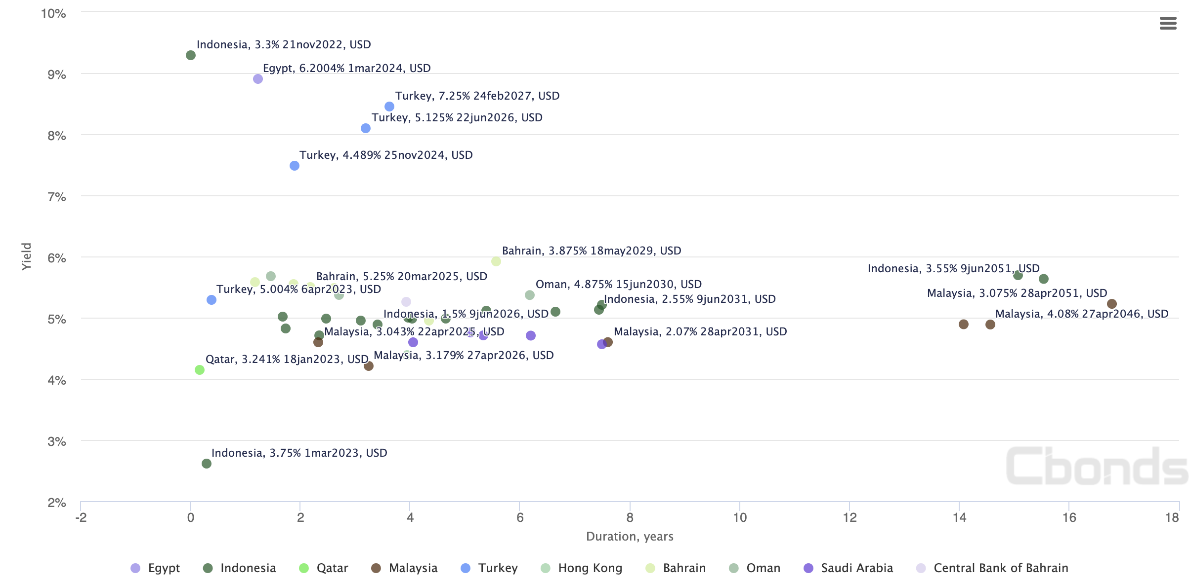
Sovereign Bond MAP, USD
Source: https://cbonds.com/

Slide 18
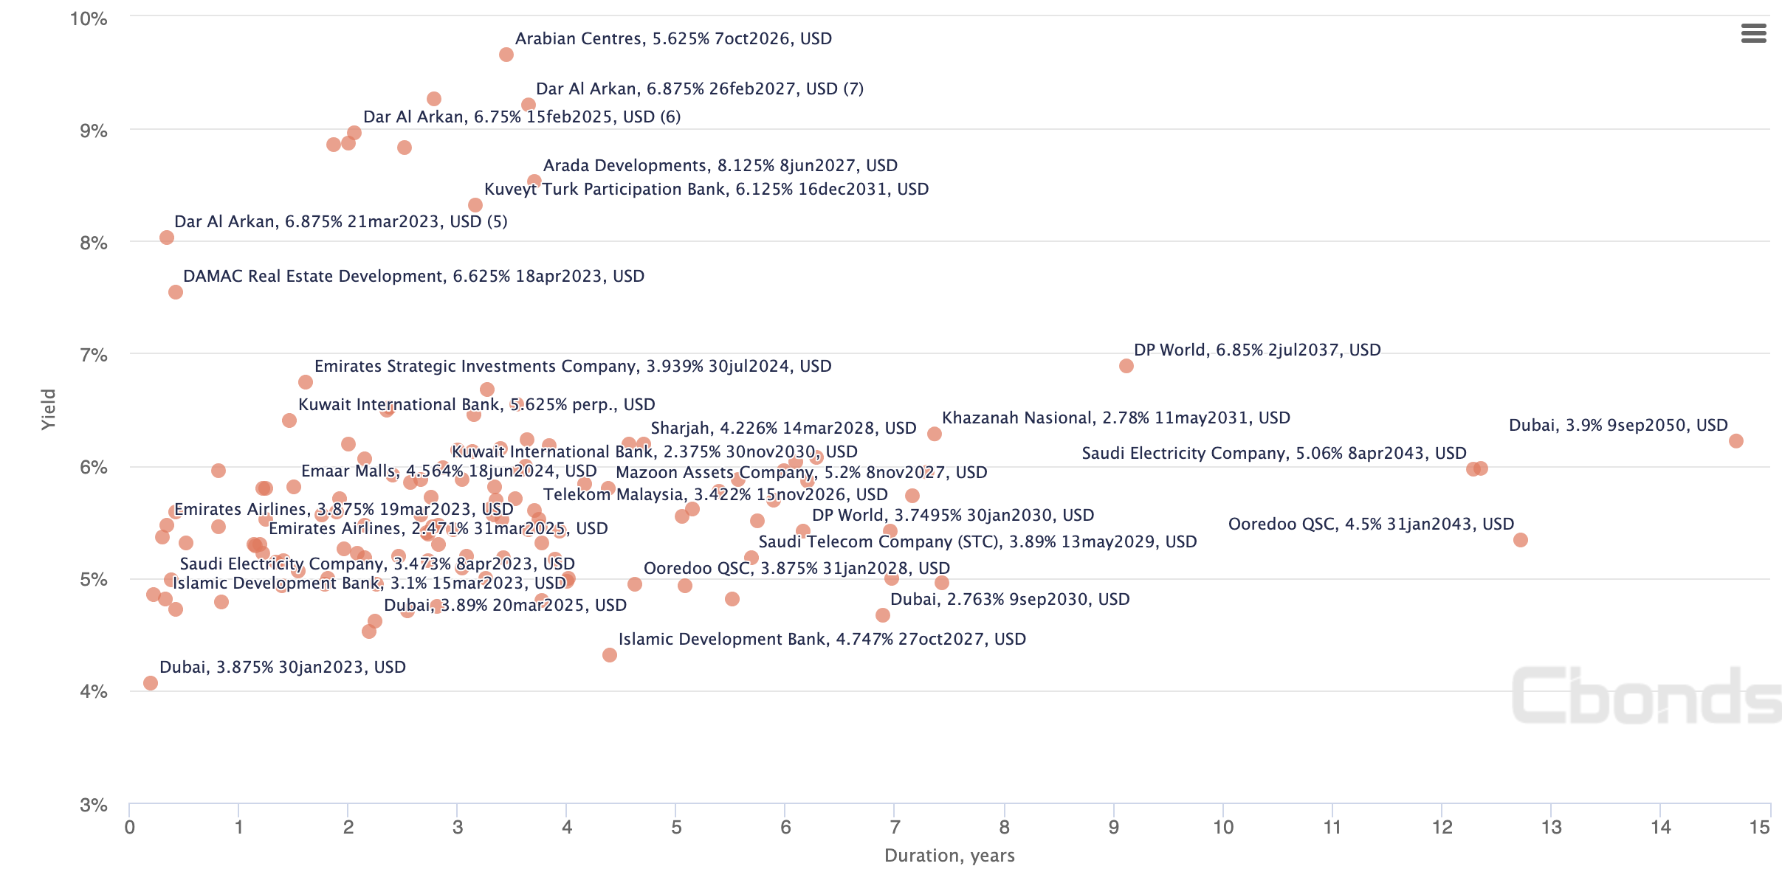
Corp and Muni Bond MAP, USD
Source: https://cbonds.com/

Slide 19
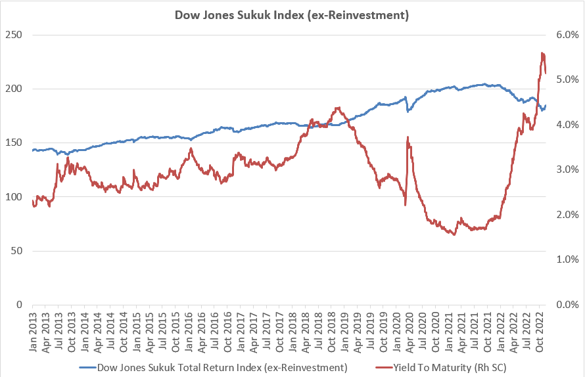
2.64% - 10 YR RETURN (Annualized)
Source: https://www.spglobal.com/spdji/en/indices/fixed-income/dow-jones-sukuk-index-ex-reinvestment/#overview

Slide 20
Trends
Fast growing market in Saudi Arabia, Turkey, Kuwait and Pakistan
New issuers from 2021: Maldives, Germany, return UK and South Africa
An increase in the average size of the issue International bonds to USD 1 bln and a decrease in the average size for Domestic bonds to USD 100 mln
Growing role of Corporate Sector in Sukuk Market
Growth in sustainability and green-themed sukuk
Standardization of documentation
Short term Sukuk increasing trend (some Countries, have adopted Bahrain’s strategy of regularly issuing short term Sukuk to support the liquidity)
Source: https://cbonds.com/

Slide 21
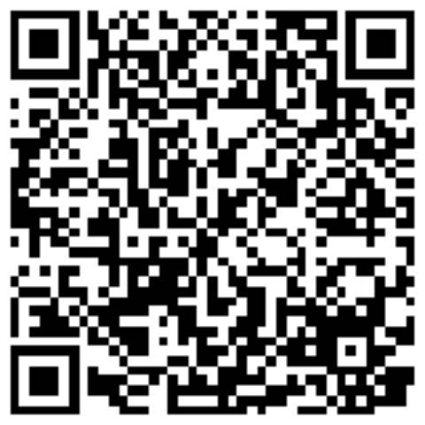
How to get trial access to https://cbonds.com/ ?
Konstantin Vasilev
Partner, Member of Board
Email: kv@cbonds.com
Phone: +971 565944066

